Slide 1
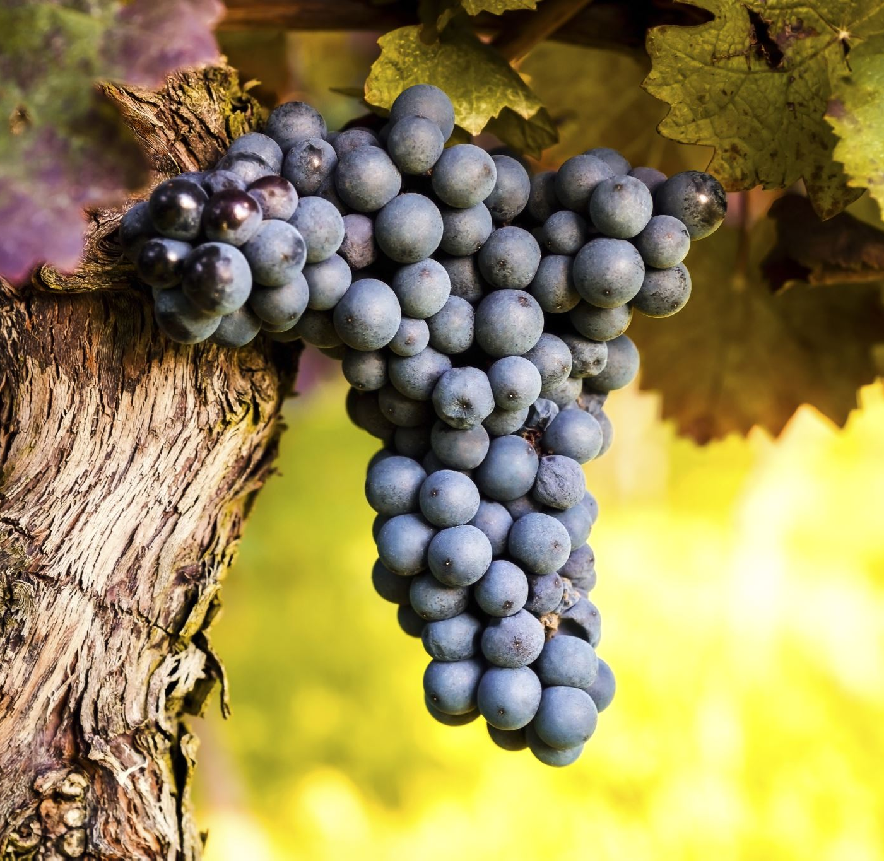
Detecting and counting of grape bunches by driving the robot autonomously and avoiding obstacle using ROS programming
ID-25403914

Slide 2
Introduction
To move the robot autonomously and count the number of fruits in the vineyard two things are important
1.Robot navigation in ROS programming
2. Robot vision

Slide 3
Navigation in Ros programming
In order to move the robot to a desired position the navigation is very important, one of the most researched areas of robotics is simultaneous localization and mapping (SLAM). Two different approaches exist to the problem of SLAM: topological and metric [3].to use the metric navigation it needs geometric model of the world also it assumes the exact sensor information and used for more precise applications. The topological navigation uses waypoints for. The navigation leads to a quantitative description of navigation goals which is flexible and easy to define a map

Slide 4
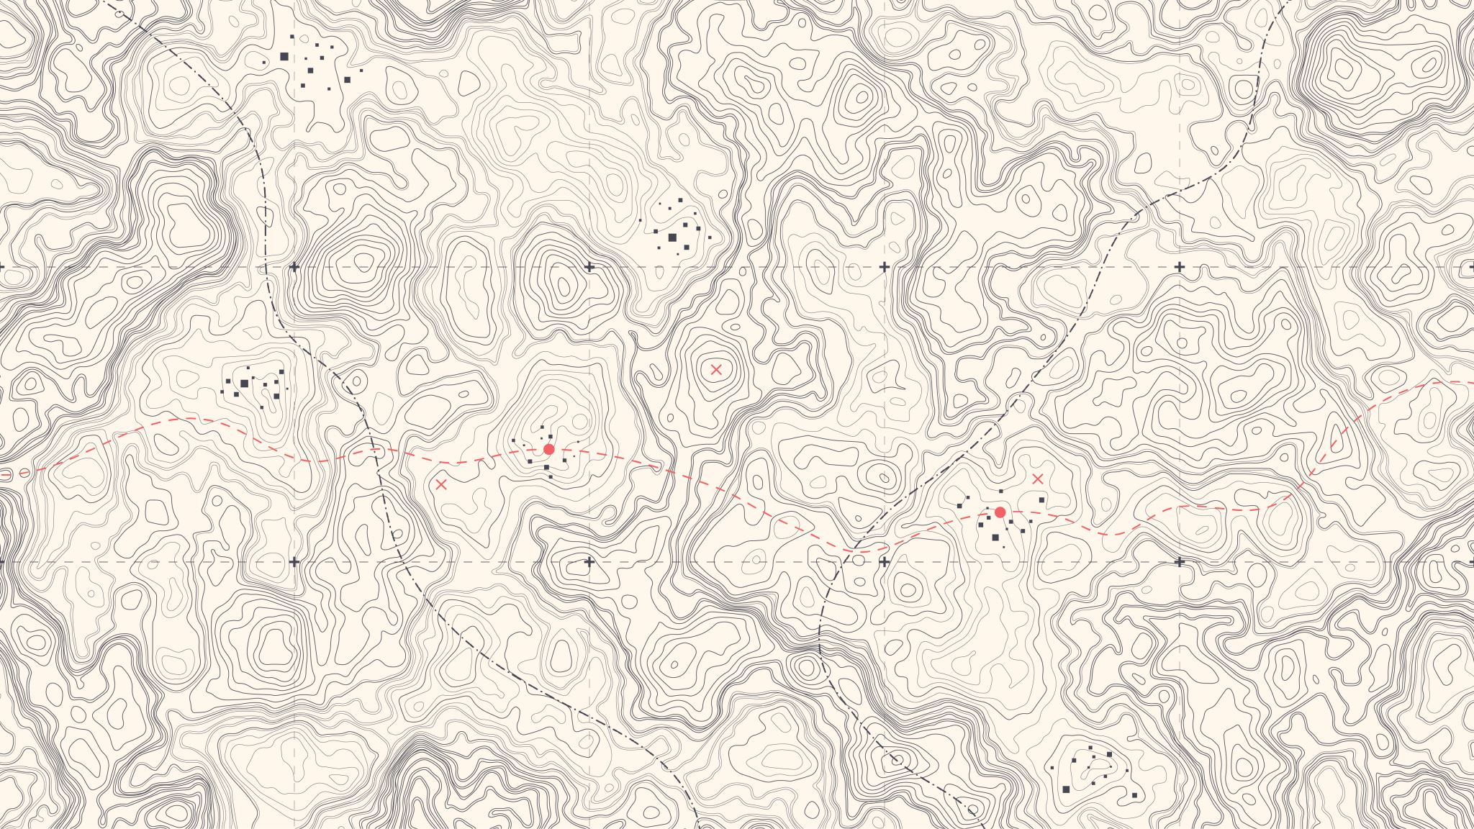
Topological navigation
The topological navigation uses waypoints for the navigation leads to a quantitative description of navigation goals which is flexible and easy to define a map
This navigation helps the robot to move in certain pattern in a vineyard field

Slide 5
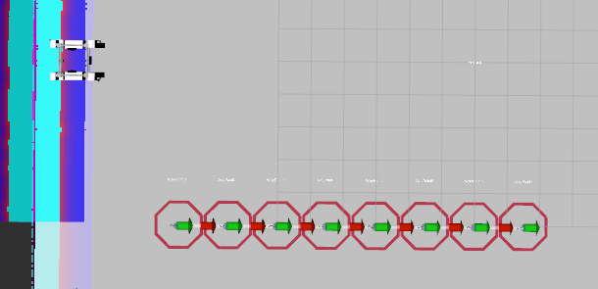
Waypoints
2D waypoints will be predefined in ROS based robots to navigate to the destination avoiding obstacles. A package that will buffer move_base goals until instructed to navigate to all waypoints in sequence

Slide 6
Adding waypoints in ROS programming
rosservice call /topological_map_manager/add_topological_node "
name: WayPoint1
pose:
position:
x: -8.0
y: -5.0
z: 0.0
orientation:
x: 0.0
y: 0.0
z: 0.0
w: 1.0
add_close_nodes: false"
origin: WayPoint0
destination: WayPoint1
action: move_base
edge_id: WayPoint0_WayPoint1"

Slide 7

autonomous motion and obstacle avoidance of robot
To move robot from one waypoint to other python script is used in ROS.
The MoveBaseGoal class is used to describe the next goal that should be moved where the new X and Y locations will be as well as the final orientation or 'pose' that will be assumed once the endpoint is reached. A SimpleActionClient is formed, and the new goal is sent to the move_basic server, which is where move_basic receives new goals. A result is requested from the move_basic server using our just used client interface

Slide 8
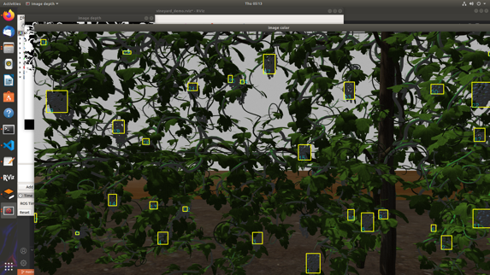
Robot vision:
The robot vision is needed for the detection and counting of grape bunches. Where, robot vision is a combination of hardware such as cameras and sensors and algorithms which enables the robot to see

Slide 9
3D vision and point cloud library (PCL)
It is a large-scale open-source library for processing 2D and 3D images, as well as point cloud processing
which has the advantage of allowing the individual points to be manipulated rather than the entire raw data.
In this it uses depth camera and RGBD sensor to locate the specific 3D object of specific colour, so the x, y and z co- ordinates of the images is obtained.
the co-ordinates of the grape is saved in the array and length of the array will give the number of grapes

Slide 10
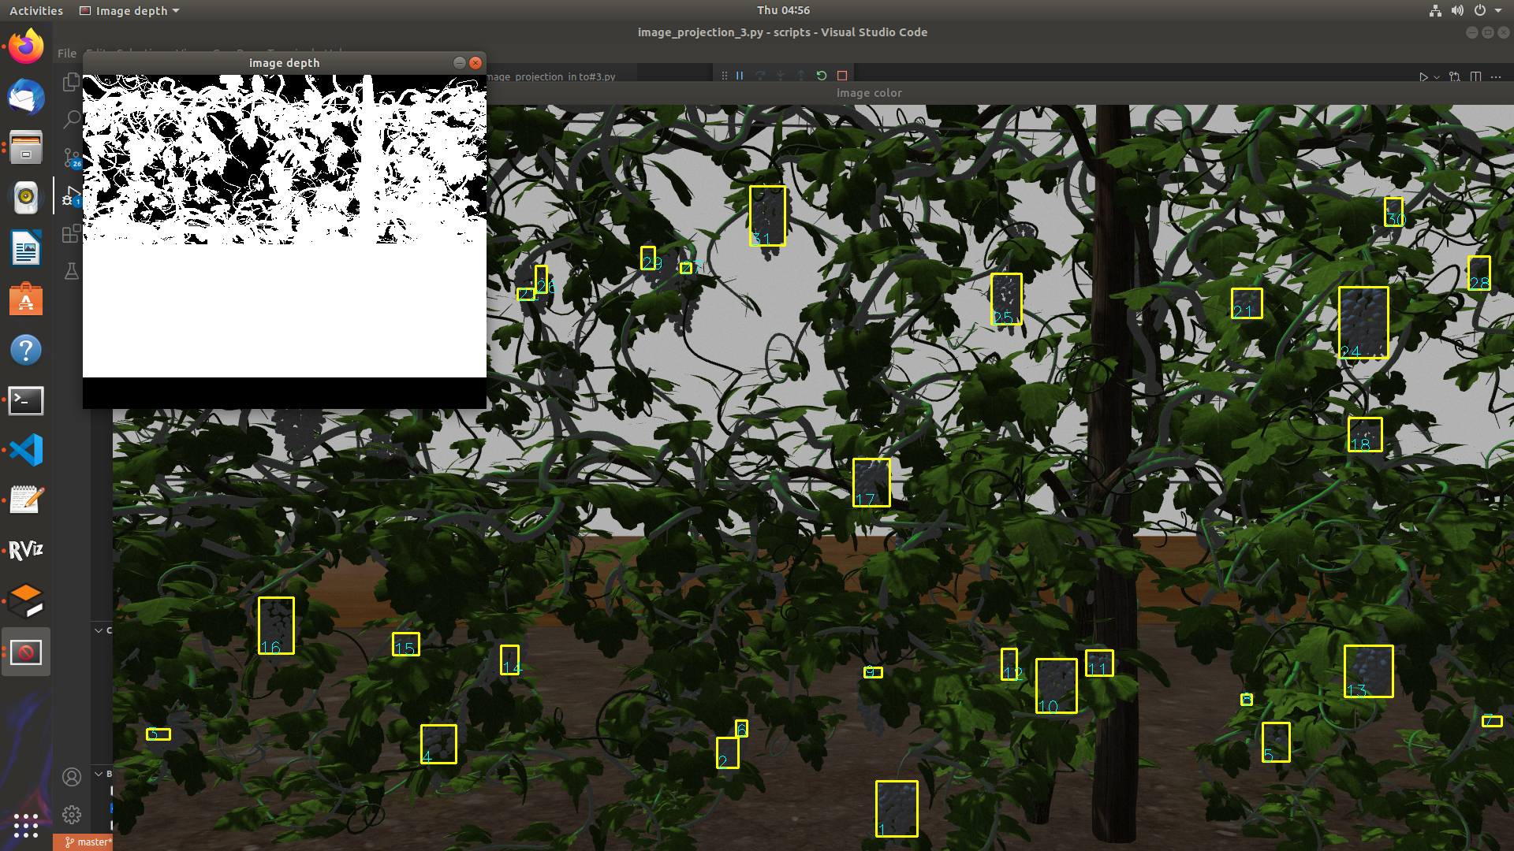
Image obtained from the depth camera and fruit detection from open cv
The rectangle indicates the number of grape bunches detected in the camera

Slide 11
Result.
The map is created by creating waypoints then saved and loaded in such a way that it should the Rviz then the robot is autonomously moved from one waypoint to other in such a way that it should follow the grape bunches and then each grape bunches co-ordinates are saved in an array using point cloud library and the length of that array gives the number of grape bunches present in the vineyard

Slide 12
Conclusion
The robot is programmed in such a way to follow the path around certain path to count number of grape bunches.
Since depth camera need certain time to detect all the grape bunches it will stay at each waypoint for 10 seconds it is a very slow process
it saves the duplicate co-ordinates of grape bunches it is not possible to remove all the duplicates, hence the number of grape bunches it counts may varies from -10% to + 10% From the actual number of grapes.

